Slide 1
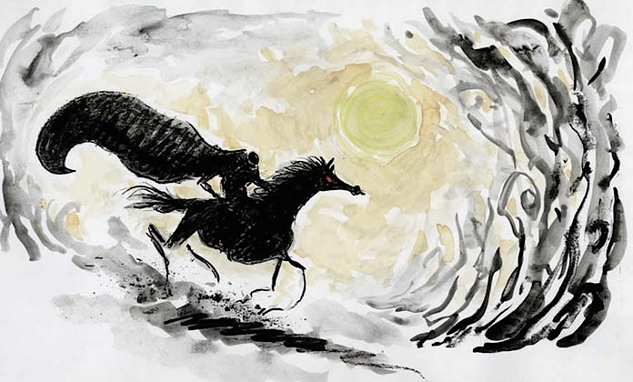
The Wonderful World of Tim Burton

Slide 2
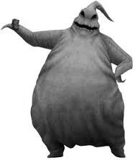
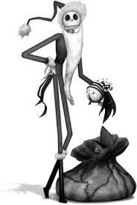
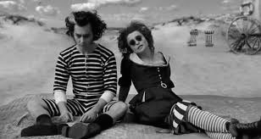
whom IS Tim burton?
Born by Timothy Walter Burton, on August 25, 1958, in Burbank CA
American Film Director, Producer, Artist, Writer and Animator
Best known for his dark, gothic, macabre, and quirky horror and fantasy films

Slide 3
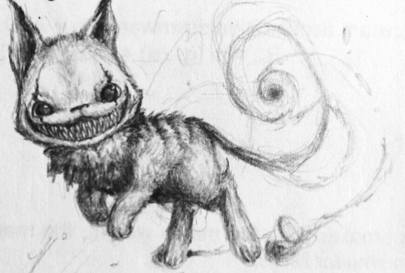
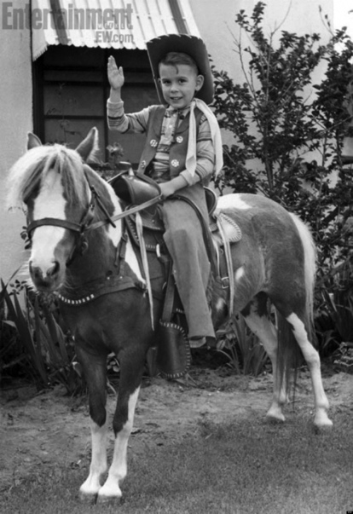
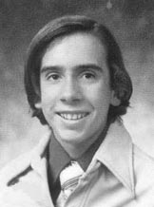
in THE BEGINNING
Father: Bill Burton- Former minor league baseball player
Mother: Jean Burton- owned a cat-themed gift shop
Went to Burbank High School
Favorite subjects: Drawing, Painting and Film
Made his first short film at 13, using short motion animation
Attended California Institution of the Arts in Santa Clarita
Studied character animation and graduated in 1979

Slide 4
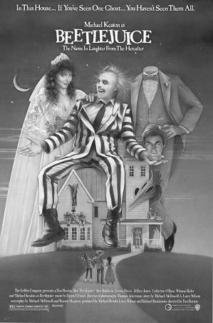
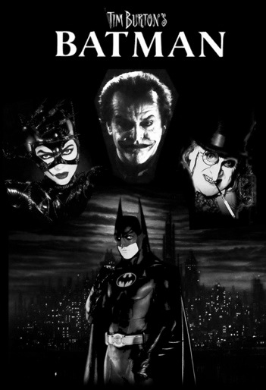
after college…
80’s:
Joined Disney Animator and Storyboard artist for:
- The Fox and the Hound
- The Black Cauldron
- Tron
Fired from Disney because his art was considered “too dark and scary for children to see”.
80’s cont’d
Developed own shorts:
- Frankeweenie
- Pee-wee’s Big Adventure
Two major Films:
- Beetlejuice
- Batman

Slide 5
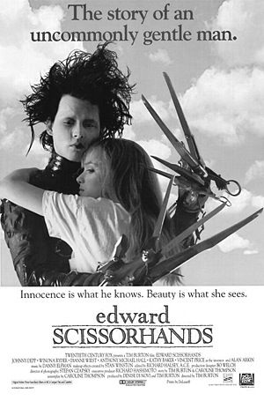
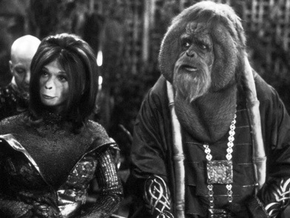
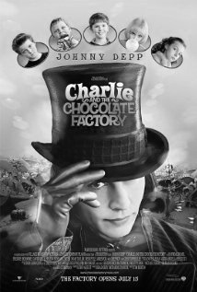
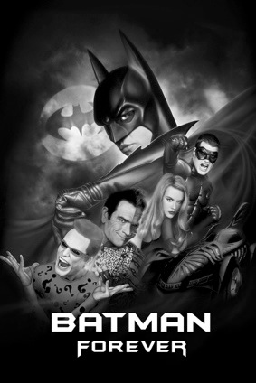
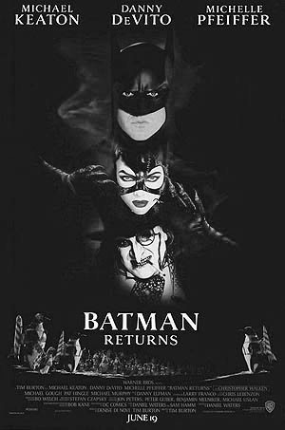
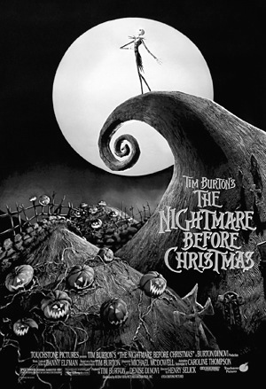
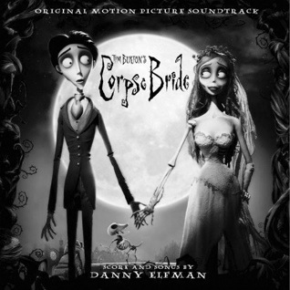
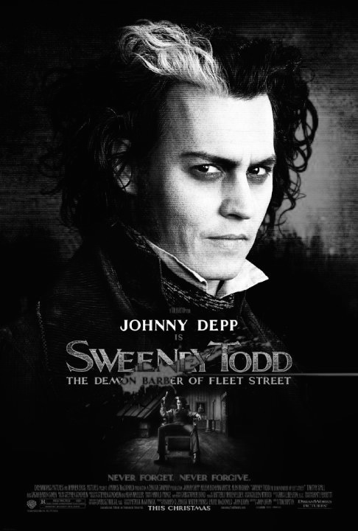
More Major Movies
90’s
Edward Scissorhands
Batman Returns
Cabin Boy
Ed Wood
Batman Forever
Nightmare Before Christmas
James and the Giant Peach
Mars Attacks
Superman Lives
Sleepy Hollow
2000’s:
Planet of the Apes
Big Fish
Charlie and the Chocolate Factory
Corpse Bride
Sweeney Todd
Directed music video “Bones” by the Killers

Slide 6
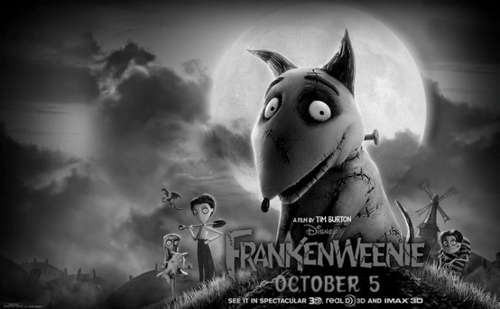
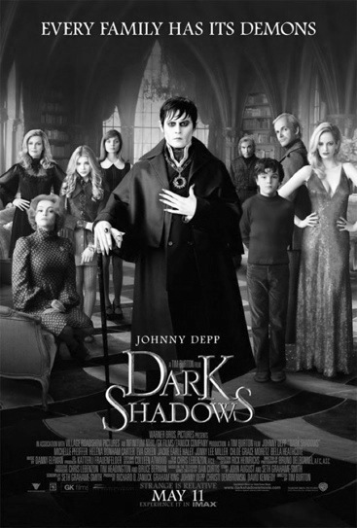
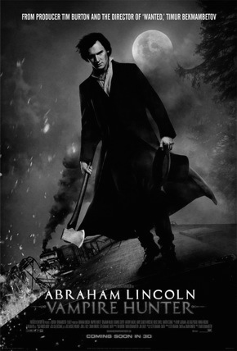
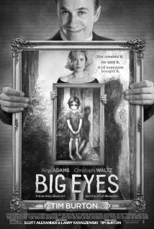
More major movies cont’d
2010’s
Alice in Wonderland
Dark Shadows
Abraham Lincoln: Vampire Hunter
Frankeweenie
Big Eyes
Directed music video “Here With Me” by the Killers

Slide 7
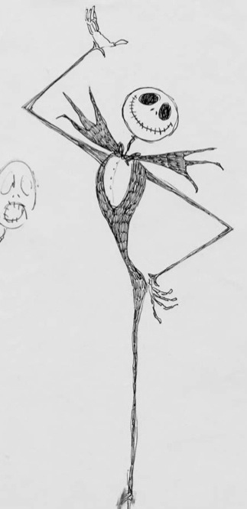
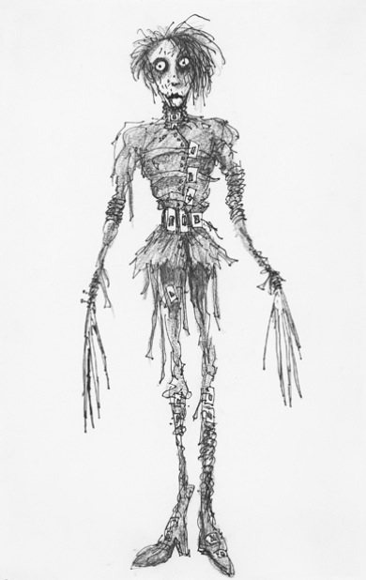
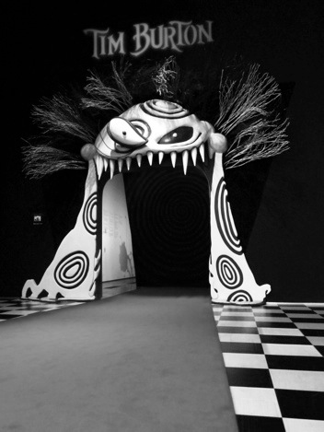
personal life
Relationship with Helena Bonham Carter
Two children:
- Bill Raymond Burton (son, 11years old)
-Nell Burton (daughter, 7 years old)
Best friend with Johnny Depp
Several films are based on drawings he made as a kid
-Edward Scissorhands
- Jack Skellington
- Frankeweenie was based on childhood dog
Still has art galleries and special exhibitions around the world

Slide 8
Take a Quiz
http://www.proprofs.com/quiz-school/story.php?title=tim-burton_5X3

